Slide 1

Graduation Rate for Top 5 Public Universities in Florida
Team Members: Cheikh Sidi El Moctar, Bridgette Sanders, Lisette Cruz, Ricardo Kenny

Slide 2

What factors affect the graduation rates within the top 5 Public Universities in
FLORIDA?
Factor Attributes:
Tuition & Fees
Acceptance Rate
Student Population
SAT Scores

Slide 3

Hypothesis
School size may affect graduation rates since smaller schools usually have a smaller student body; thus, smaller class sizes. This most often means more individualized attention for each student.
Universities requiring an above average ACT/SAT may have higher graduation rates as these are the students that are good test takers which will be reflected in the classroom; thus, positively impacting graduation rate.
Universities with higher acceptance rates may translate to lower graduation rates as a higher acceptance rate may mean that the admission requirements are low.
Cost of Tuition will affect graduation rates since higher tuition costs may deter students from graduating to prevent further accumulation of debt.

Slide 4





Top 5 Public Universities
University of Florida
Florida State University
University of Central Florida
University of South Florida
Florida International University

Slide 5
Analysis Approach and Tools
Set Clear Measurement Priorities
Tools:
Pandas
Matplotlib
SciPy. Stats
Seaborn
Git, GitHub
Data acquisition by scraping using Pandas
Data Cleaning, messaging, and visualization
Analysis
Finding Interpretation
Conclusion

Slide 6
Analysis Approach
Data source : 2019 Acceptance Rate Comparison between Colleges in Florida
Filtering Florida from the dataset using Pandas
Filtering the Florida dataset for target universities (top 5 universities).
The following tables were cleaned and filtered:
Graduation Rate
Acceptance Rate
SAT & ACT test Scores
Tuition Fees
Student Population
Limitations
Time constraint.
Incomplete data
Data quality.

Slide 7
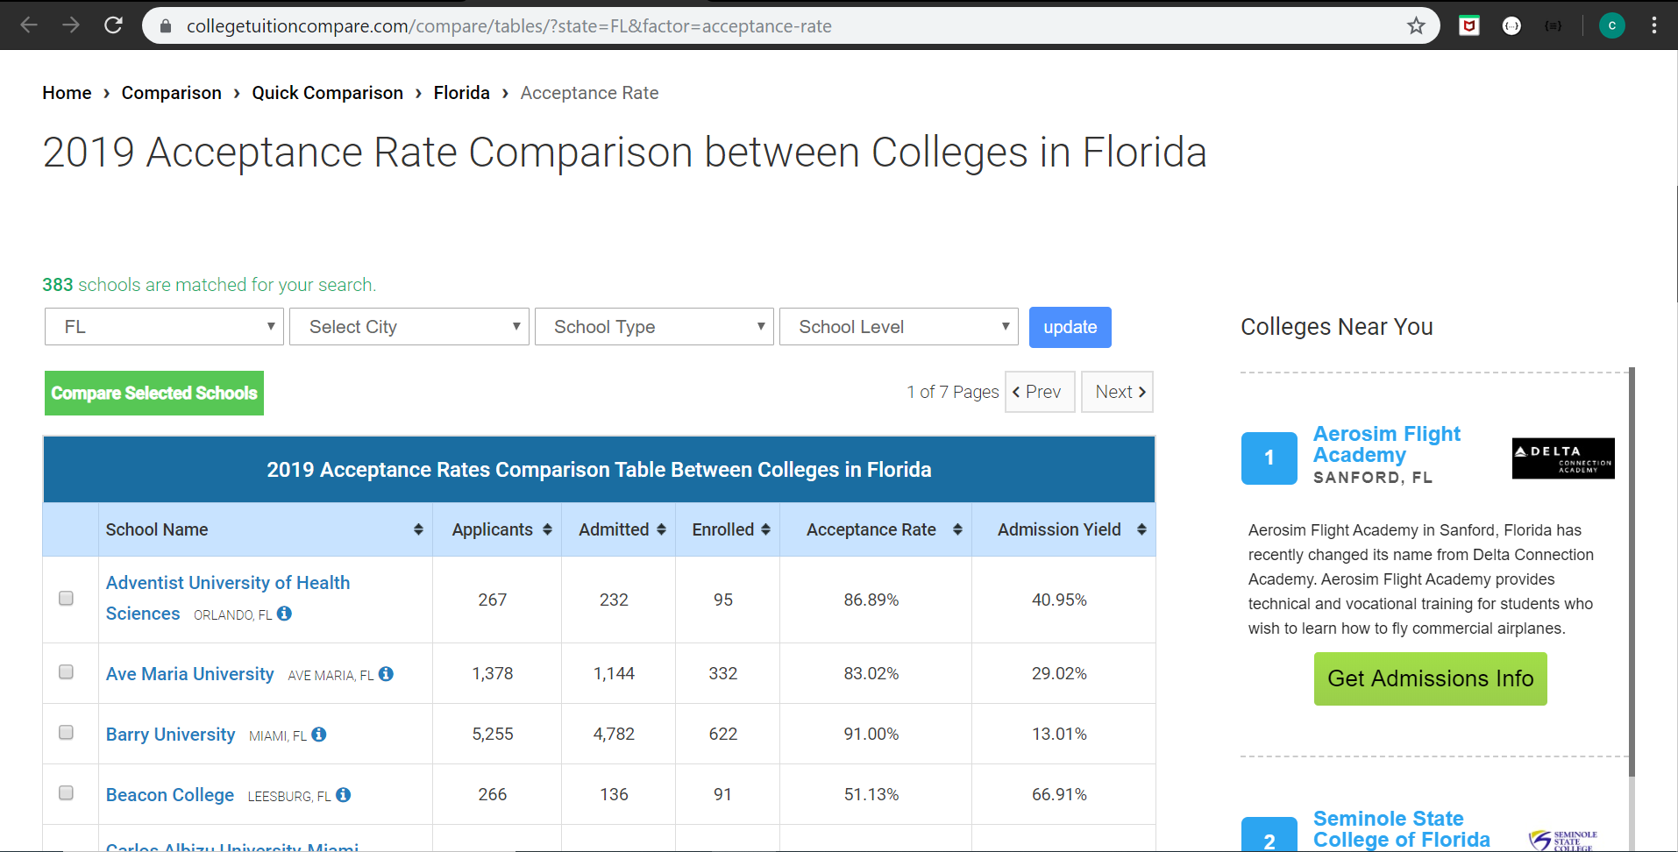
Data Source

Slide 8
Graduation Rate Table
 | State | School Abrev | School Name | Graduation Rate | Transfer-out Rate | Transfer-out Rate (BS degree) | Retention Rate (Full-time) | Retention Rate (Part-time)
0 | FL | FIU | Florida International University Miami, FL | 57.0 | 19.0 | 1.0 | 88.0 | 77.0
1 | FL | FSU | Florida State University Tallahassee, FL | 80.0 | 7.0 | 3.0 | 94.0 | 79.0
2 | FL | UCF | University of Central Florida Orlando, FL | 70.0 | 7.0 | 4.0 | 90.0 | 80.0
3 | FL | UF | University of Florida Gainesville, FL | 88.0 | 3.0 | 2.0 | 96.0 | 81.0
4 | FL | USF | University of South Florida-Main Campus Tampa... | 71.0 | 6.0 | 3.0 | 90.0 | 77.0

Slide 9
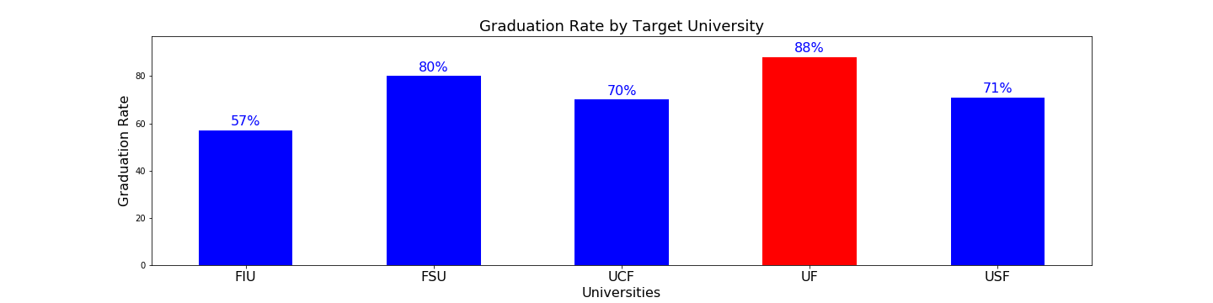
Graduation Rates %

Slide 10
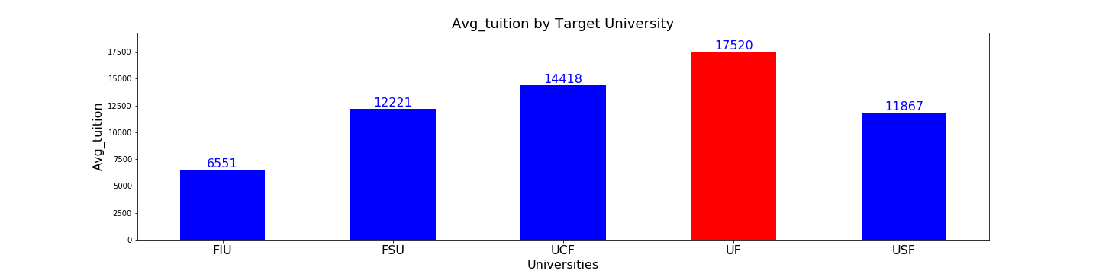
Average Tuition Fees

Slide 11
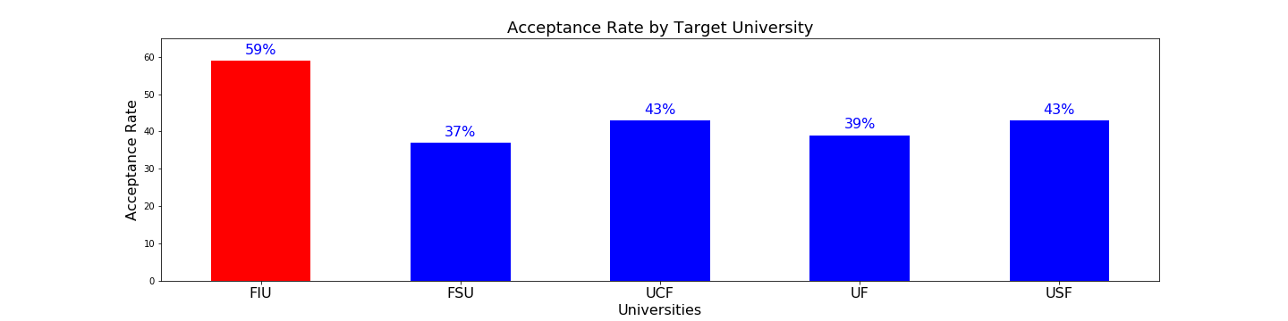
Acceptance Rate %

Slide 12
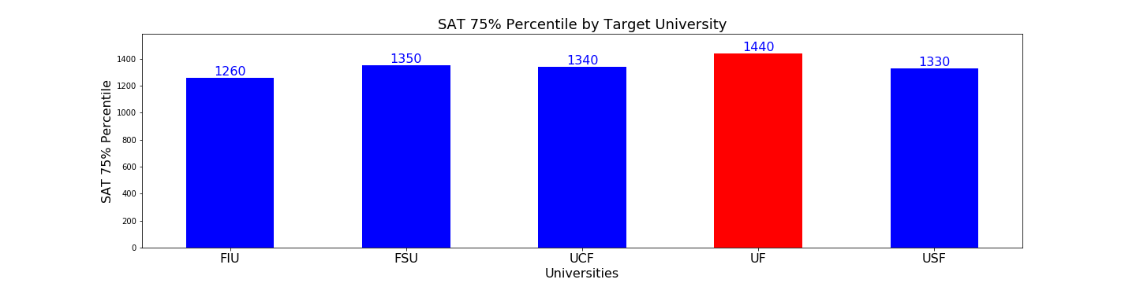
SAT Scores

Slide 13
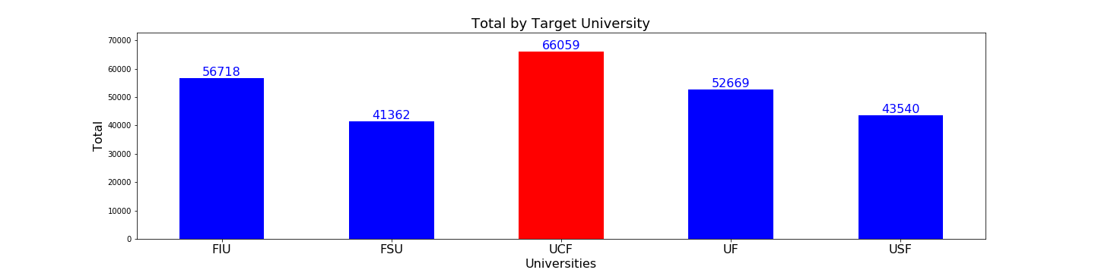
Total Student Population

Slide 14



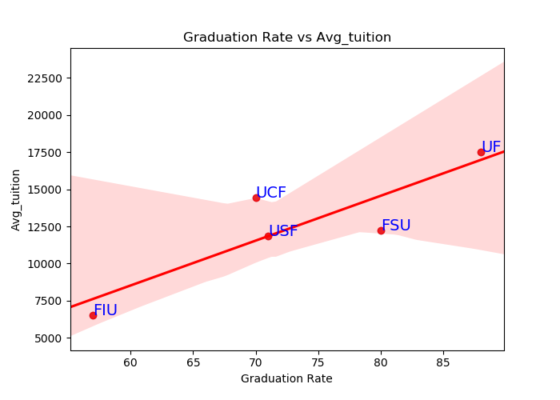


Graduation Rate versus Avg. Tuition

Slide 15

Graduations vs. Tuition & Fees Correlation
The graph above shows a strong positive correlation between the Graduation Rate and Tuition Fees.
Higher tuition rates positively affects graduation rates.

Slide 16
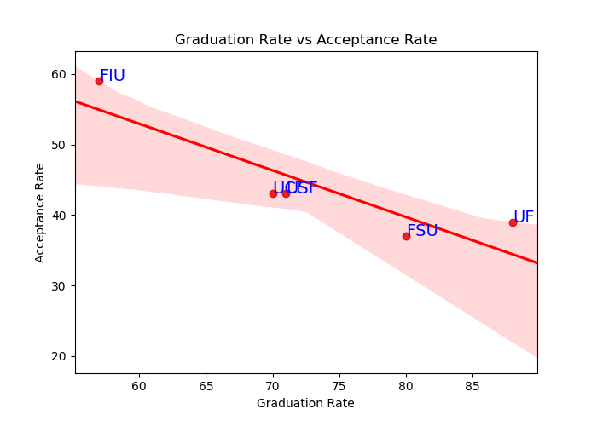
Graduation Rate versus Acceptance Rate

Slide 17
Graduations vs. Acceptance Correlation
The graph above shows a strong negative correlation between the Graduation rate and Acceptance rate.
Higher acceptance rates decreases graduation rates

Slide 18
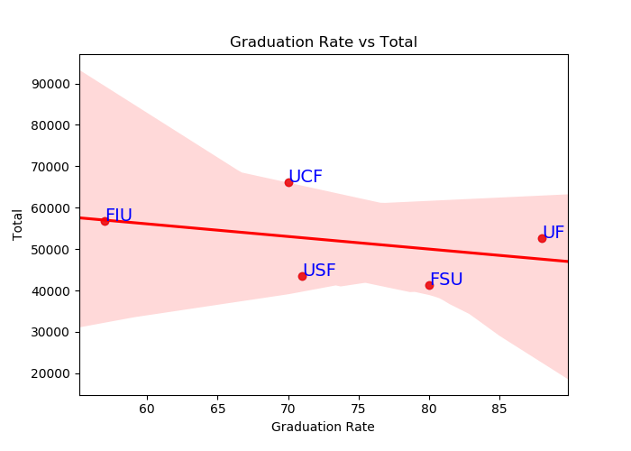
Graduation Rate versus Total Student

Slide 19
Graduations vs. Total Student Correlation
The graph above shows little to no correlation between the Graduation rate and Total Students.
Total students (school size) doesn’t affect the graduation rate.

Slide 20
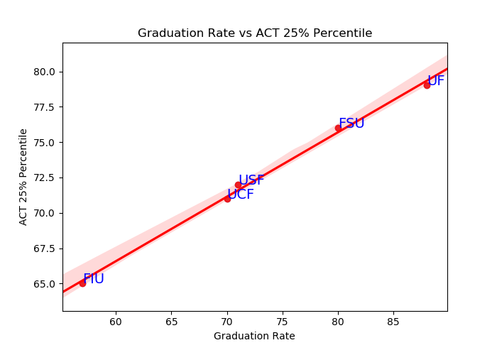
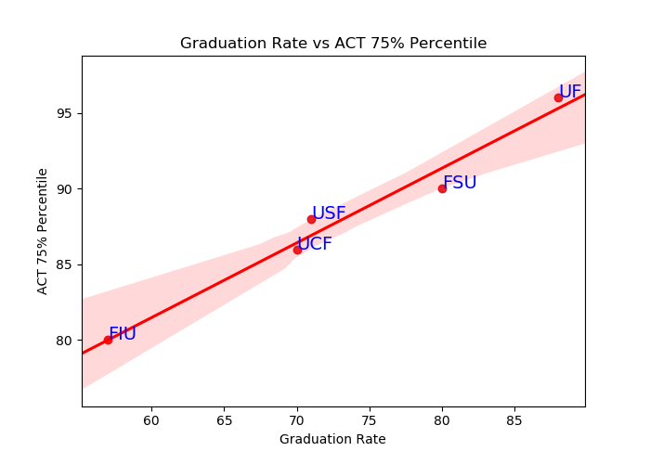
ACT Scores

Slide 21
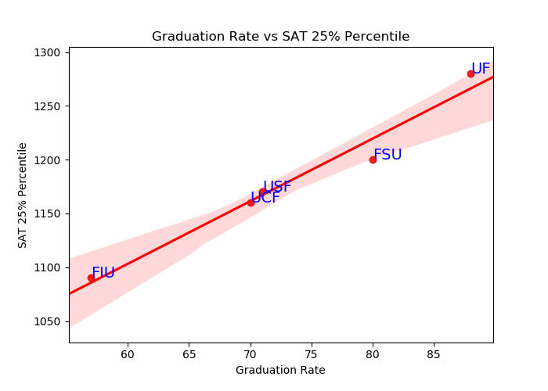
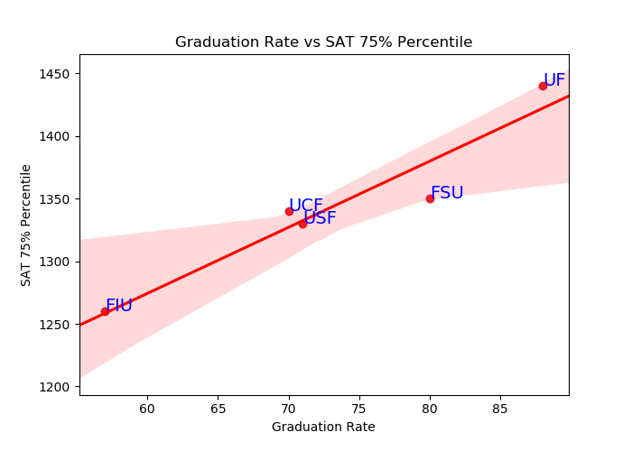
SAT Scores

Slide 22
Graduations vs. ACT, SAT test scores Correlation
The graph above shows a strong positive correlation between the Graduation rate and test scores (SAT, ACT).
Higher required test scores increases graduation rate.

Slide 23
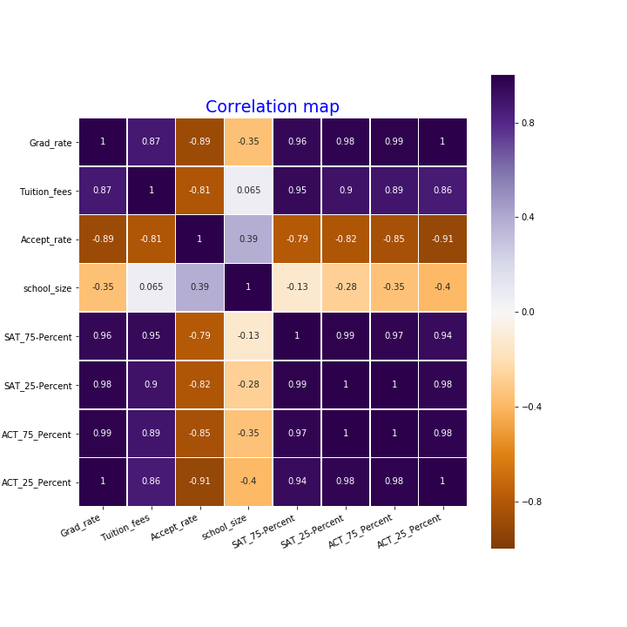
Given the data we have, we were not able to run a t-test to test the Null Hypothesis.
The heat map pictured shows a correlation between all the variables. The dark violet color signifies a positive correlation and the dark orange signifies a negative correlation.
Strong positive correlation between the SAT, ACT test scores, Avg Tuition and graduation rates.
Strong negative correlation between Graduation Rate and Acceptance Rate.
Little to no correlation between Graduation Rate and Total Student Population.

Slide 24
College Admissions typical considerations
Consistent Solid scores on the SAT or ACT
A well-written essay that provides insight into the student's personality, values, and goals
Anecdotal letters of recommendation from teachers and the student's counselor that give evidence of his or her intellectual curiosity, special skills, and positive character traits.
Demonstrated enthusiasm for attending a university, as evidenced by a campus visit, interview, and ongoing contact with the admission office.
Demonstrated intellectual curiosity through reading, school, and extracurricular pursuits, summer activities, and more

Slide 25



What drives the Graduation rate within the top 5 Universities in the Sunshine State of FLORIDA?
Given the limited dataset size we have, we have concluded:
The more rigorous admission requirements with high SAT, ACT scores, coupled with the high cost of Tuition, the better college appears to be.
In this sense, we can say higher standardized test scores do show a correlation with college success as it's usually defined. ... Whether a student does well on the SAT or ACT can be affected by a variety of factors aside from the student's inherent aptitude.
The higher the Acceptance rate on the other hand means less Admission requirement, more lower grad students and less Graduation rate.
The Total number of students (school size) seems to have less to no correlation with the graduation rates form the analysis, whether the school is large or small, the graduation rate trend remain the static.

Slide 26



